Slide 1
Push Down Automata (PDA)

Slide 2
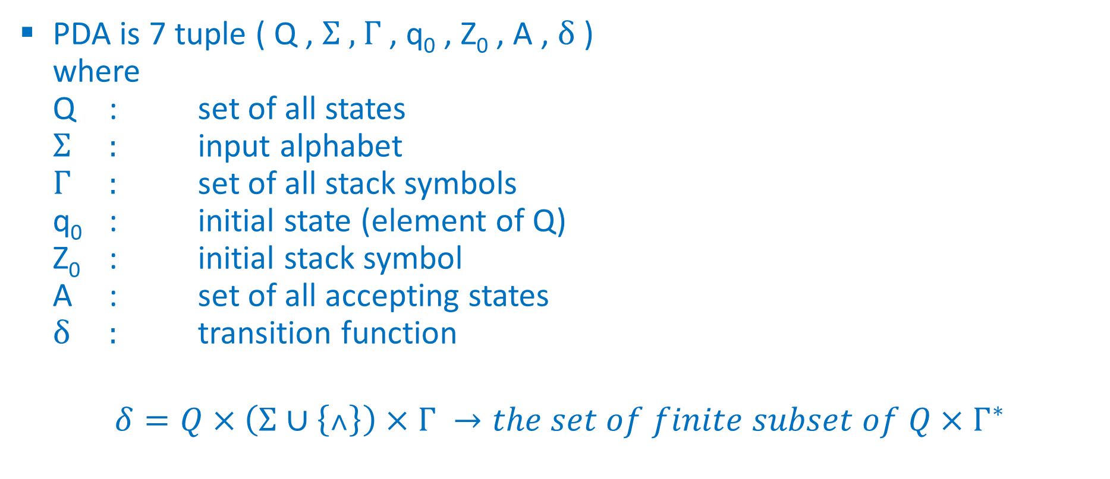
Definition
PDA is 7 tuple ( Q , Σ , Γ , q₀ , Z₀ , A , δ )
where
Q : set of all states
Σ : input alphabet
Γ : set of all stack symbols
q₀ : initial state (element of Q)
Z₀ : initial stack symbol
A : set of all accepting states
δ : transition function
$$δ=Q×\left(Σ∪\left\{˄\right\}\right)×Γ →the set of finite subset of Q×Γ^{∗}$$

Slide 3
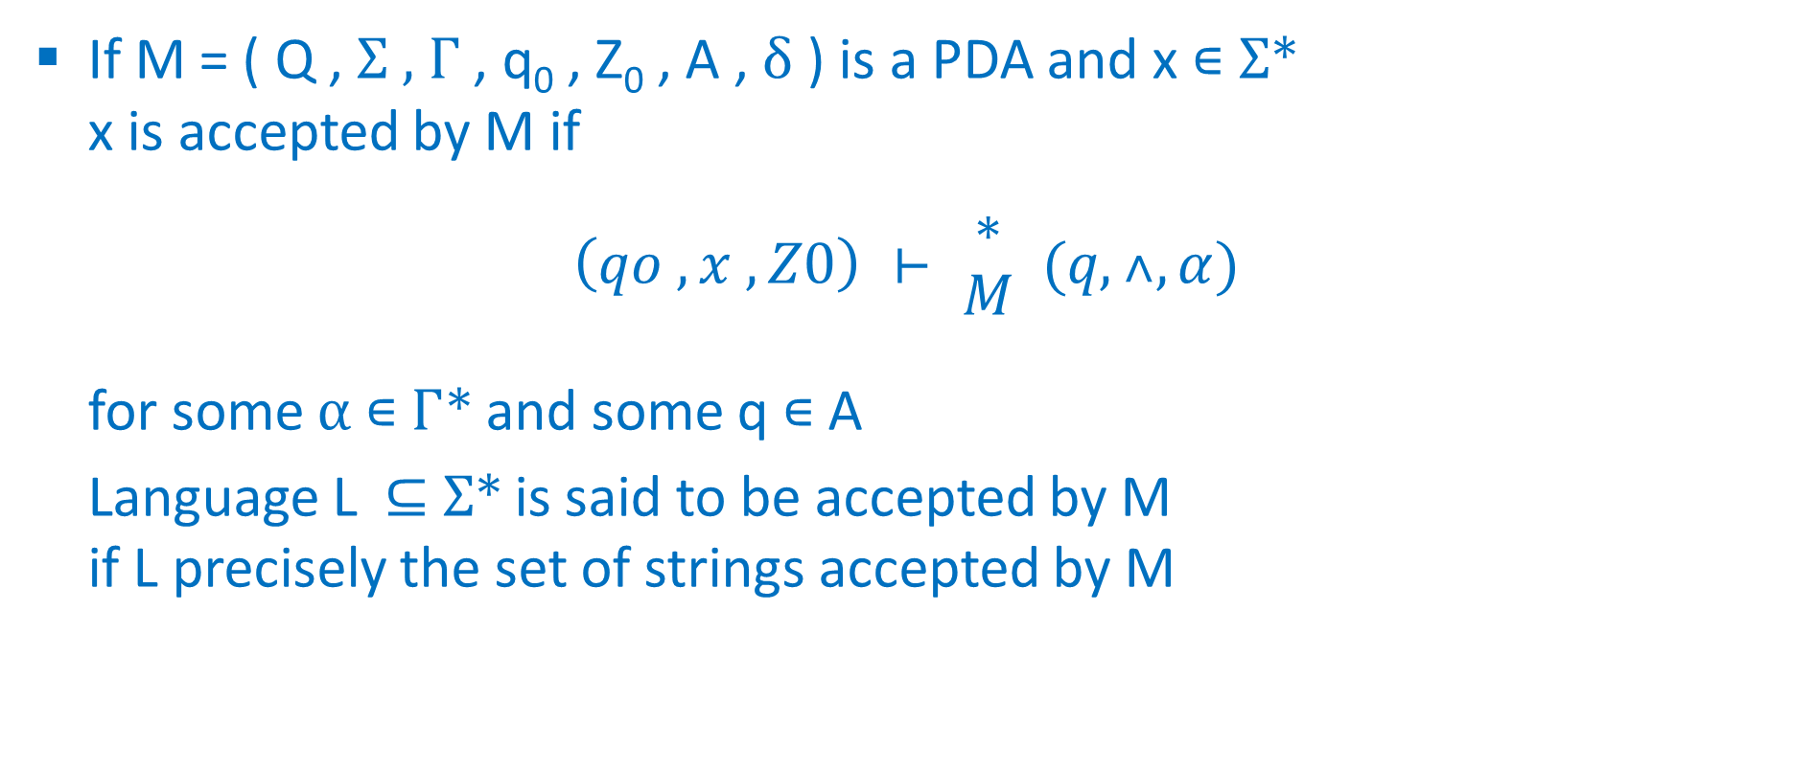
Acceptance by PDA
If M = ( Q , Σ , Γ , q₀ , Z₀ , A , δ ) is a PDA and x ∊ Σ*
x is accepted by M if
$$\left(qo , x , Z0\right) ⊢ \begin{matrix}∗ \\ M\end{matrix} (q,˄,α)$$
for some α ∊ Γ* and some q ∊ A
Language L ⊆ Σ* is said to be accepted by M
if L precisely the set of strings accepted by M

Slide 4
PDA
Basics

Slide 5
Compare FA and PDA
Accept
All Context Free Languages
(All Regular + Some Non-regular)
PDA
FA
Accept
All Regular Languages

Slide 6
Compare FA,PDA,TM
 | Accepted by
 | FA | PDA
Regular languages e.g. a*b* | ✓ | ✓
Context free languages e.g. a^{n}b^{n} | × | ✓
 | FA | PDA
Memory | Finite memory | Infinite memory (Stack)

Slide 7
Basic of PDA
PDA has infinite amount of memory in form of Stack
with bottom symbol Z₀
Stack
Infinite size
Z₀

Slide 8
Operations for PDA
3 operation
  Push
  Pop
  Skip
Normal idea to create PDA is
when you are performing same operation the remain on same state
When you change operation the change the state

Slide 9
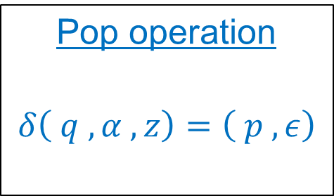
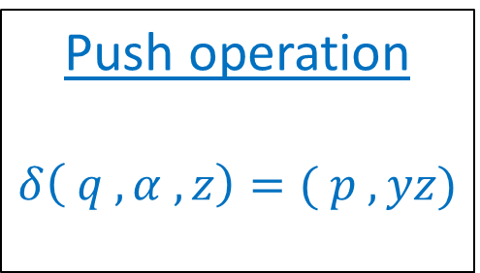
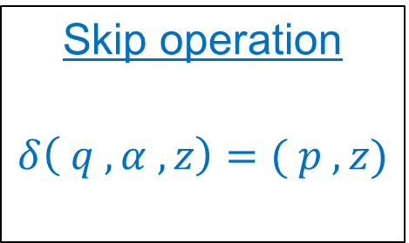
δ for PDA
Push operation
$$δ\left( q , α , z\right)=( p , yz)$$
Pop operation
$$δ\left( q , α , z\right)=\left( p , ε\right)$$
Skip operation
$$δ\left( q , α , z\right)=( p , z)$$
Current
state
New
state
Input
symbol
Symbol
Pushed
in stack
Stack
top
symbol

Slide 10
δ for PDA
Push operation
$$δ\left( q , α , z\right)=( p , yz)$$
Pop operation
$$δ\left( q , α , z\right)=\left( p , ε\right)$$
Skip operation
$$δ\left( q , α , z\right)=( p , z)$$
Current
state
Input
symbol
Null
Stack
top
symbol

Slide 11
δ for PDA
Push operation
$$δ\left( q , α , z\right)=( p , yz)$$
Pop operation
$$δ\left( q , α , z\right)=\left( p , ε\right)$$
Skip operation
$$δ\left( q , α , z\right)=( p , z)$$
Current
state
Input
symbol
Stack
top
symbol

Slide 12
Acceptance by PDA
PDA accept string in two ways
  Acceptance by empty stack
    After reading the entire input if the stack is empty then the string is accepted by PDA
  Acceptance by final state
    After reading the entire input id PDA reaches to the final state the string is accepted

Slide 13
Types of PDA
DPDA
NPDA
Deterministic PDA
Nondeterministic PDA
NPDA is more powerful than DPDA
All string accepted by DPDA can be accepted by NPDA but vice versa is not true
NPDA can have multiple transition for same pair (input symbol , stack top symbol), which not possible in DPDA

Slide 14
EX-1 : L = { a^{n}b^{n} | n>=0 }
Logic:
  Push all “a” in stack
  For “b” pop “a” from stack
  In differentiate input and stack symbol push “Z1” in place of “a”

Slide 15
EX-1 : L = { a^{n} b^{n} | n>=0 }
Input string
a a a b b b ϵ
push
push
push
pop
pop
pop
skip
String empty
&
Stack empty
so
Accepted
Z₁
Z₁
Z₁
Z₀

Slide 16
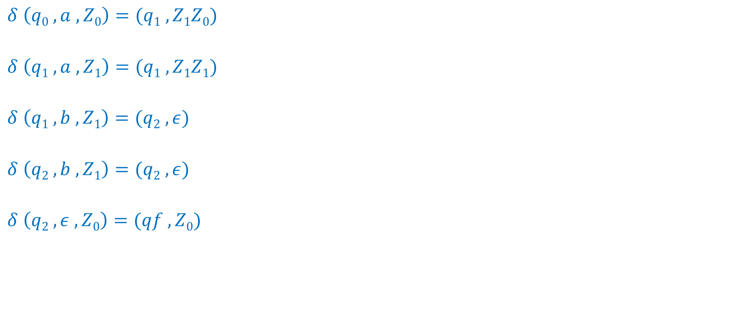
EX-1 : L = { a^{n} b^{n} | n>=1 }
Operation : PUSH
First operation : change state
$$δ \left(q0 , a , Z0\right)=(q1 ,Z1Z0)$$
$$δ \left(q1 , a , Z1\right)=(q1 ,Z1Z1)$$
$$δ \left(q1 , b , Z1\right)=(q2 , ε)$$
$$δ \left(q2 , b , Z1\right)=(q2 , ε)$$
$$δ \left(q2 , ε , Z0\right)=(qf , Z0)$$
Operation : PUSH
same operation as above, don't change state
Operation : POP
different operation, change state
Operation : POP
same operation as above, don't change state
Operation : SKIP
different operation, change state
q0
a,Z₀|Z₁Z₀
q1
b,Z₁|ϵ
q2
ϵ,Z₀|Z₀
qf
DPDA
a,Z₁|Z₁Z₁
b,Z₁|ϵ

Slide 17
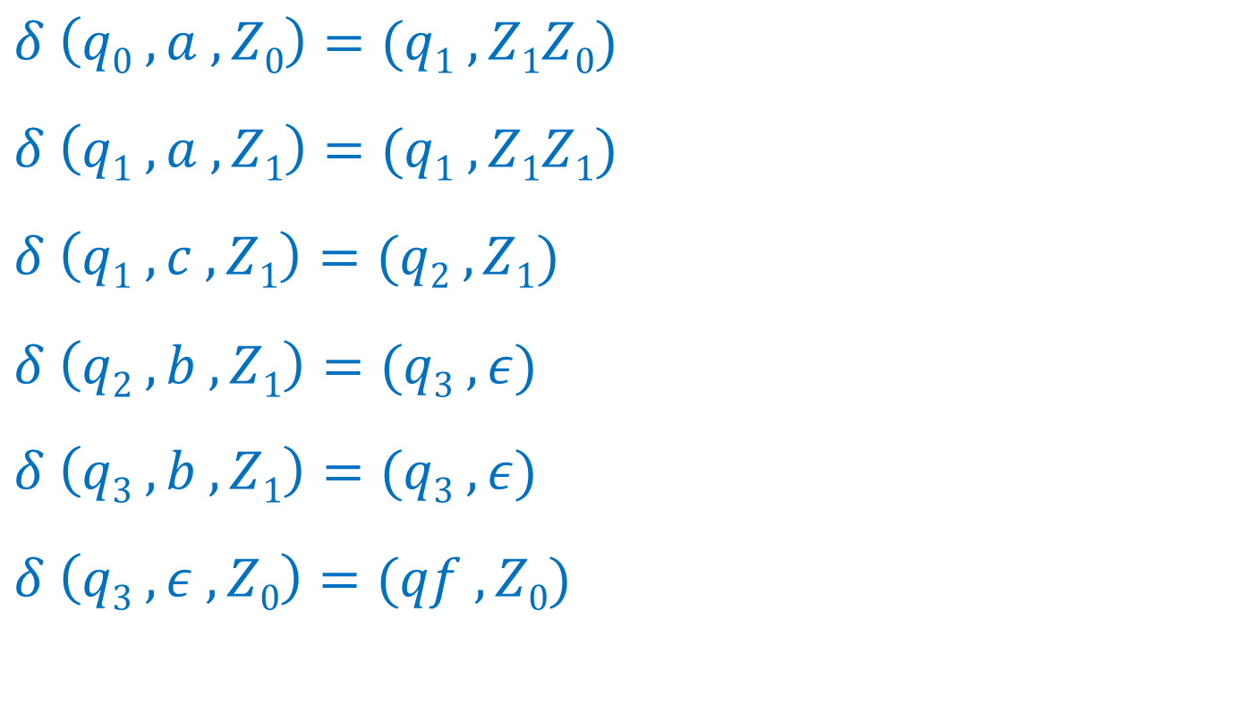
EX-2 : L = { a^{n} c b^{n} | n>=1 }
DPDA
q0
$$δ \left(q0 , a , Z0\right)=(q1 ,Z1Z0)$$
$$δ \left(q1 , a , Z1\right)=(q1 ,Z1Z1)$$
$$δ \left(q1 , c , Z1\right)=(q2 , Z1)$$
$$δ \left(q2 , b , Z1\right)=(q3 , ε)$$
$$δ \left(q3 , b , Z1\right)=(q3 , ε)$$
$$δ \left(q3 , ε , Z0\right)=(qf , Z0)$$
a,Z₀|Z₁Z₀
q1
a,Z₁|Z₁Z₁
c,Z₁|Z₁
q2
b,Z₁|ϵ
q3
ϵ,Z₀|Z₀
qf
b,Z₁|ϵ

Slide 18
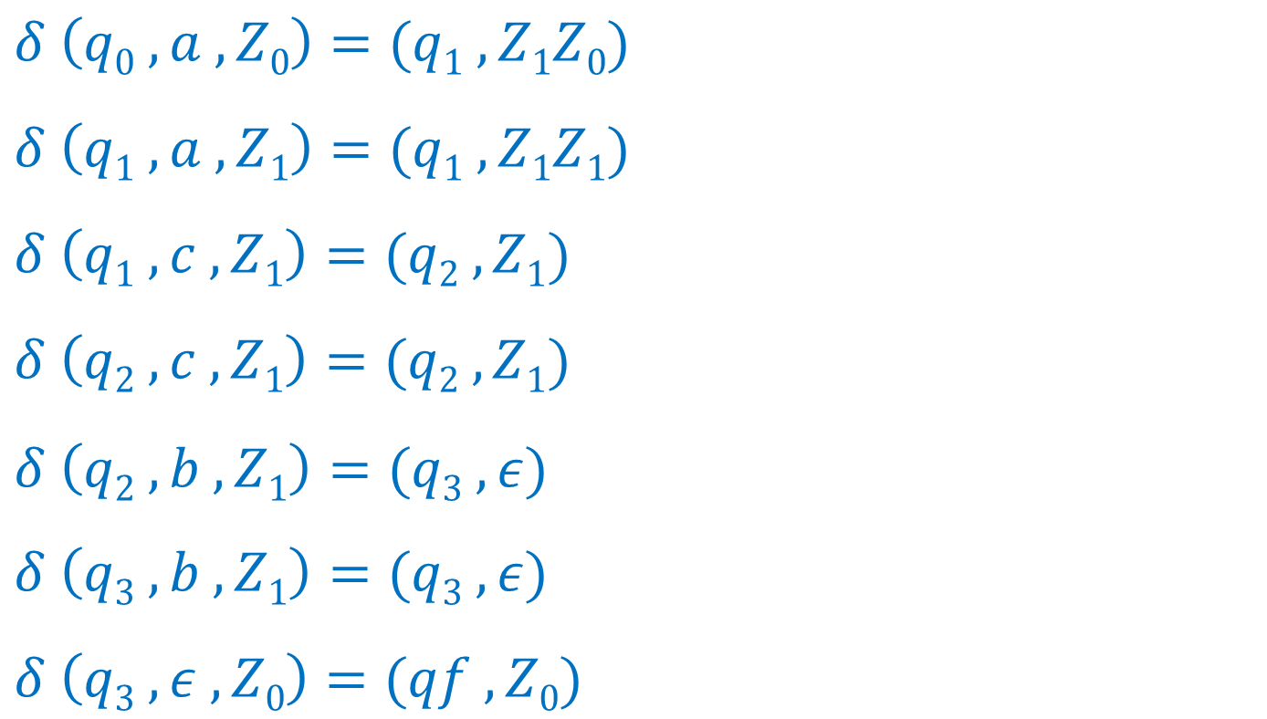
EX-3 : L = { a^{n} c^{m} b^{n} | n,m>=1}
DPDA
q0
$$δ \left(q0 , a , Z0\right)=(q1 ,Z1Z0)$$
$$δ \left(q1 , a , Z1\right)=(q1 ,Z1Z1)$$
$$δ \left(q1 , c , Z1\right)=(q2 , Z1)$$
$$δ \left(q2 , c , Z1\right)=(q2 , Z1)$$
$$δ \left(q2 , b , Z1\right)=(q3 , ε)$$
$$δ \left(q3 , b , Z1\right)=(q3 , ε)$$
$$δ \left(q3 , ε , Z0\right)=(qf , Z0)$$
a,Z₀|Z₁Z₀
q1
a,Z₁|Z₁Z₁
c,Z₁|Z₁
q2
c,Z₁|Z₁
b,Z₁|ϵ
q3
ϵ,Z₀|Z₀
qf
b,Z₁|ϵ

Slide 19
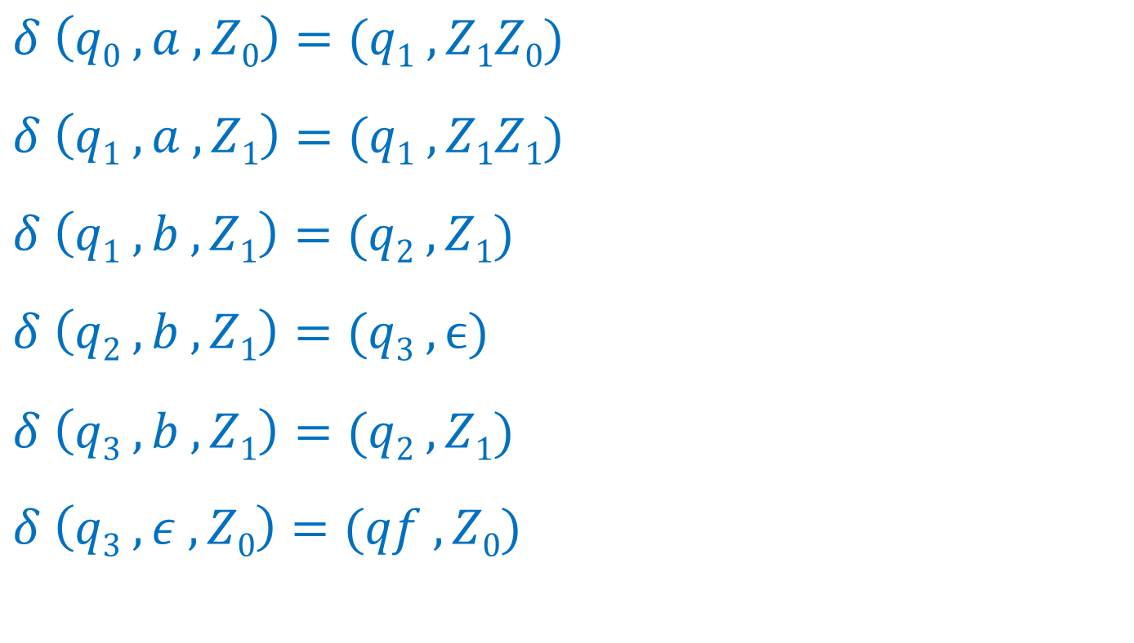
EX-4 : L = { a^{n} b^{2n} | n>=1 }
DPDA
q1
$$δ \left(q0 , a , Z0\right)=(q1 ,Z1Z0)$$
$$δ \left(q1 , a , Z1\right)=(q1 ,Z1Z1)$$
$$δ \left(q1 ,b , Z1\right)=(q2 , Z1)$$
$$δ \left(q2 , b , Z1\right)=(q3 , ϵ)$$
$$δ \left(q3 , b , Z1\right)=(q2 ,Z1)$$
$$δ \left(q3 , ε , Z0\right)=(qf , Z0)$$
a,Z₀|Z₀Z₁
q1
b,Z₁|Z₁
q2
a,Z₁|Z₁Z₁
b,Z₁|Z₁
b,Z₁|ϵ
qf
ϵ,Z₀|Z₀
q3

Slide 20
EX-5 : L = { WcW^{R} | W∊{a,b}* , W^{R} is reverse of W }
Input string
a b a b c b a b a ϵ
Skip
Z₂
String empty
&
Stack empty
so
Accepted
Z₁
Z₂
Z₁
Z₀

Slide 21
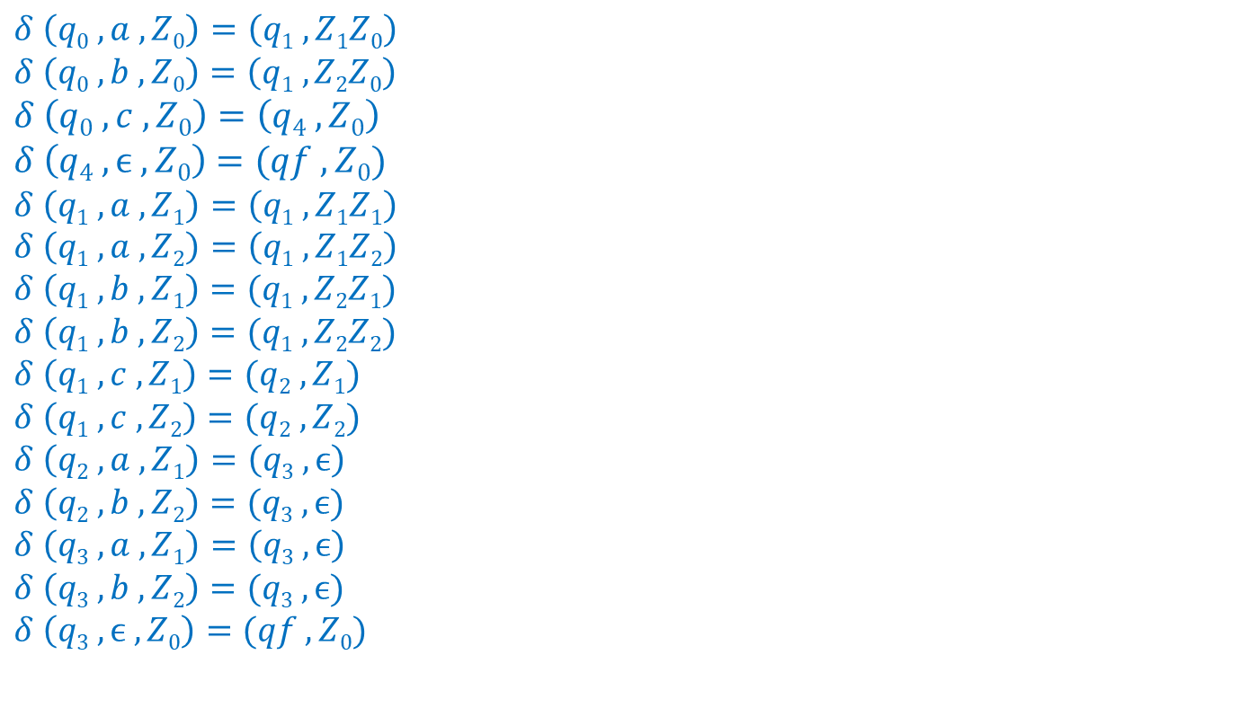
EX-5 : L = { WcW^{R} | W∊{a,b}* , W^{R} is reverse of W }
DPDA
$$δ \left(q0 , a , Z0\right)=\left(q1 ,Z1Z0\right)$$
$$δ \left(q0 , b , Z0\right)=\left(q1 ,Z2Z0\right)$$
$$δ \left(q0 , c , Z0\right)=\left(q4 ,Z0\right)$$
$$δ \left(q4 , ϵ , Z0\right)=(qf ,Z0)$$
$$δ \left(q1 , a , Z1\right)=\left(q1 ,Z1Z1\right)$$
$$δ \left(q1 , a , Z2\right)=\left(q1 ,Z1Z2\right)$$
$$δ \left(q1 , b , Z1\right)=(q1 ,Z2Z1)$$
$$δ \left(q1 , b , Z2\right)=(q1 ,Z2Z2)$$
$$δ \left(q1 , c , Z1\right)=(q2 ,Z1)$$
$$δ \left(q1 , c , Z2\right)=(q2 ,Z2)$$
$$δ \left(q2 , a , Z1\right)=\left(q3 ,ϵ\right)$$
$$δ \left(q2 , b , Z2\right)=(q3 ,ϵ)$$
$$δ \left(q3 , a , Z1\right)=\left(q3 ,ϵ\right)$$
$$δ \left(q3 , b , Z2\right)=(q3 ,ϵ)$$
$$δ \left(q3 , ϵ , Z0\right)=(qf ,Z0)$$
c,Z₀|Z₀
q0
q4
a,Z₀|Z₁Z₀
b,Z₀|Z₂Z₀
c,Z₁|Z₁
c,Z₂|Z₂
ϵ Z₀|Z₀
q1
q2
a,Z₁|ϵ
b,Z₂|ϵ
a,Z₁|Z₁Z₁
a,Z₂|Z₁Z₂
b,Z₁|Z₂Z₁
b,Z₂|Z₂Z₂
q3
ϵ,Z₀|Z₀
qf
a,Z₁|ϵ
b,Z₂|ϵ

Slide 22
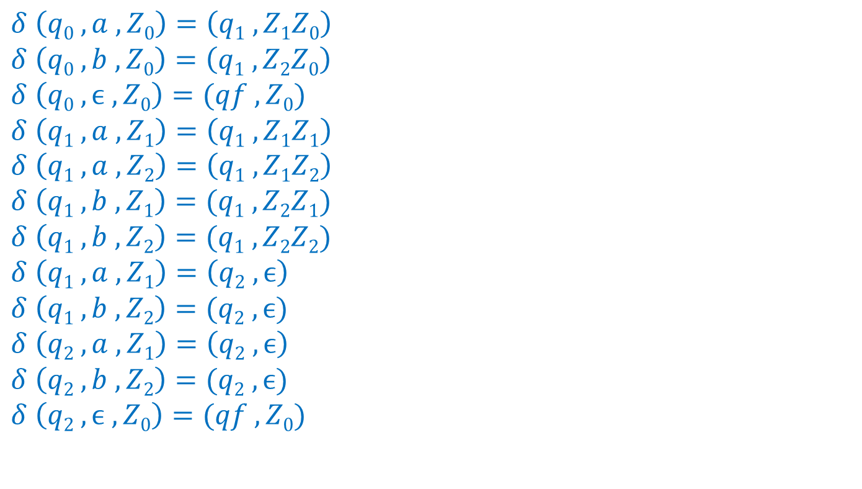
EX-6 : L = { WW^{R} | W∊{a,b}* , W^{R} is reverse of W }
NPDA
$$δ \left(q0 , a , Z0\right)=\left(q1 ,Z1Z0\right)$$
$$δ \left(q0 , b , Z0\right)=\left(q1 ,Z2Z0\right)$$
$$δ \left(q0 , ϵ , Z0\right)=(qf ,Z0)$$
$$δ \left(q1 , a , Z1\right)=\left(q1 ,Z1Z1\right)$$
$$δ \left(q1 , a , Z2\right)=\left(q1 ,Z1Z2\right)$$
$$δ \left(q1 , b , Z1\right)=(q1 ,Z2Z1)$$
$$δ \left(q1 , b , Z2\right)=(q1 ,Z2Z2)$$
$$δ \left(q1 , a , Z1\right)=\left(q2 ,ϵ\right)$$
$$δ \left(q1 , b , Z2\right)=(q2 ,ϵ)$$
$$δ \left(q2 , a , Z1\right)=\left(q2 ,ϵ\right)$$
$$δ \left(q2 , b , Z2\right)=(q2 ,ϵ)$$
$$δ \left(q2 , ϵ , Z0\right)=(qf ,Z0)$$
q0
ϵ Z₀|Z₀
aZ₀|Z₁Z₀
bZ₀|Z₂Z₀
aZ₁|ϵ
bZ₂|ϵ
q1
aZ₁|Z₁Z₁
aZ₂|Z₁Z₂
bZ₁|Z₂Z₁
bZ₂|Z₂Z₂
q2
ϵ Z₀|Z₀
qf
aZ₁|ϵ
bZ₂|ϵ

Slide 23
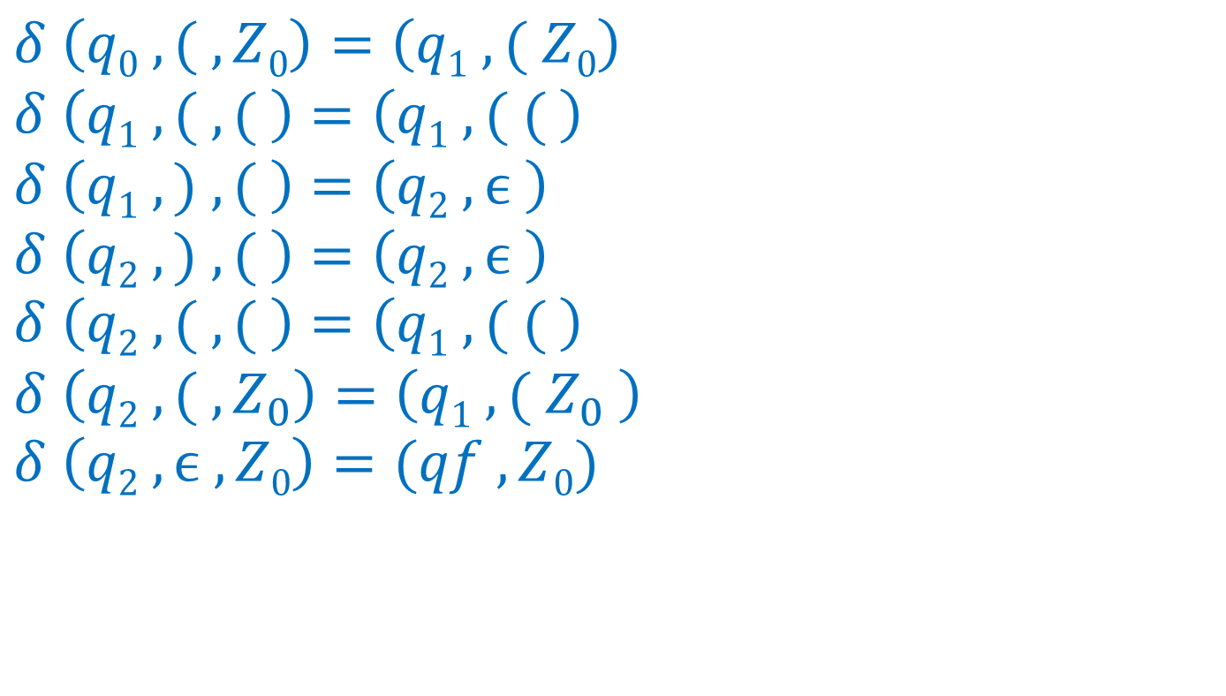
EX-7 : Balanced parenthesis
DPDA
( ( | ( (
$$δ \left(q0 , ( , Z0\right)=\left(q1 ,( Z0\right)$$
$$δ \left(q1 , ( , ( \right)=\left(q1 ,( ( \right)$$
$$δ \left(q1 , ) , ( \right)=\left(q2 ,ϵ \right)$$
$$δ \left(q2 , ) , ( \right)=\left(q2 ,ϵ \right)$$
$$δ \left(q2 , ( , ( \right)=\left(q1 ,( ( \right)$$
$$δ \left(q2 , ( , Z_{0}\right)=\left(q1 ,( Z_{0} \right)$$
$$δ \left(q2 , ϵ , Z0\right)=(qf ,Z0)$$
( Z₀| ( Z₀
q1
q0
( ( | ( (
( Z₀| ( Z₀
) ( | ϵ
q2
ϵ Z₀|Z₀
qf
) ( | ϵ

